Slide 1
Microsoft Graph for the .NET Developer
T229
Mike Ammerlaan
Product Marketing Manager, Office Ecosystem
@mikeamm

Slide 2
Session objectives and takeaways
At the end of this session, you should be
better able to…
Learning objective 1: Understand Microsoft Graph scenarios & ideas
Learning objective 1: Understand Microsoft Graph technically
Key takeaway 1: Build an app that uses Microsoft Graph

Slide 3
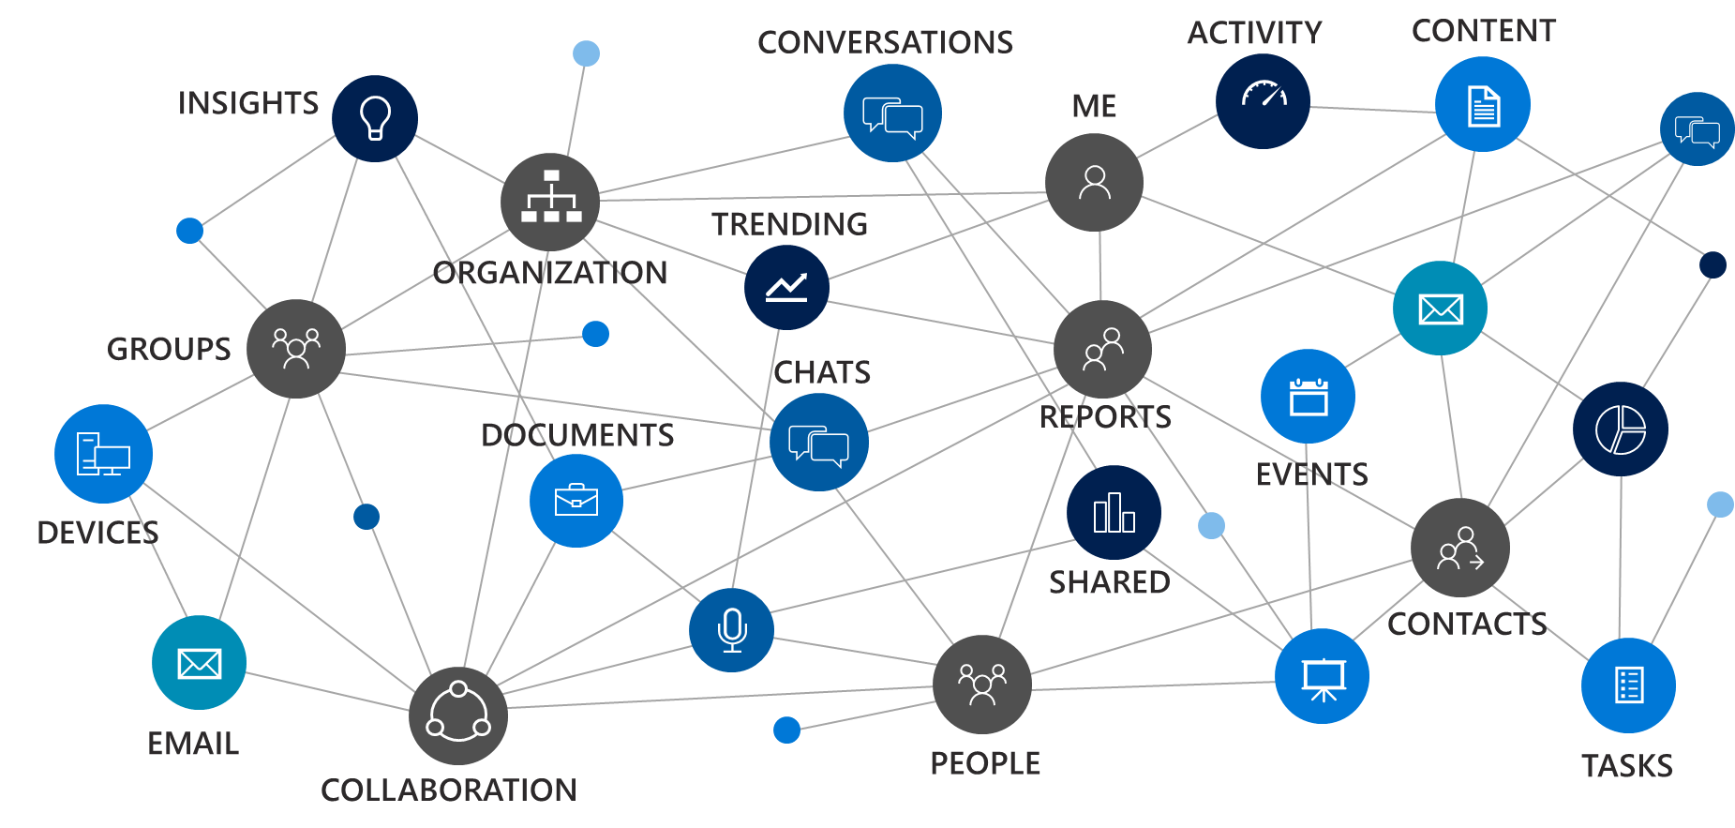
The opportunity
Fundamentals of Microsoft Graph
Agenda
Using Microsoft Graph
Roadmap

Slide 4

Opportunity
90%
of Fortune 500 companies
100M
monthly active users
50K+
new SMBs per month
8T
resources
Are using data in Microsoft Graph
Office 365 commercial subscriptions
In Office 365
in Microsoft Graph
(emails, events, calendar, users, files)

Slide 5








CONVERSATIONS
ACTIVITY
CONTENT
INSIGHTS
ME
TRENDING
ORGANIZATION
GROUPS
CHATS
DOCUMENTS
REPORTS
EVENTS
SHARED
DEVICES
CONTACTS
EMAIL
PEOPLE
SITES
TASKS

Slide 6
The opportunity
Fundamentals of Microsoft Graph
Agenda
Using Microsoft Graph
Roadmap

Slide 7


Microsoft Graph
Data
Capabilities

Slide 8
- User, group and organizational
Data
Microsoft Teams API - preview
Project Rome API - preview
SharePoint Sites API – GA
OneNote API – GA
Planner API – GA
One endpoint
One token
All users
Your app
https://graph.microsoft.com
Users
Groups
Excel
Outlook
Calendar
OneNote
Teams
Planner
Intune
Azure AD
SharePoint

Slide 9
Microsoft Graph
CONVERSATIONS
ACTIVITY
CONTENT
INSIGHTS
ME
TRENDING
ORGANIZATION
GROUPS
CHATS
DOCUMENTS
REPORTS
EVENTS
DEVICES
SHARED
CONTACTS
EMAIL
PEOPLE
TASKS
COLLABORATION

Slide 10

With Microsoft Graph
GET: /users/mikeam
{
"displayName": "Mike",
"jobTitle": "DIR, PRODUCT MTKG ECOSYSTEM",
}
GET: /users/mikeam/photo/…
{}
GET: /users/mikeam/manager
{"displayName": "Rob", …}
GET: /users/mikeam/directReports
"value" : [
{"displayName": "Matt", …},
{"displayName": "Dmitry", …},
]
GET: /me/memberOf/…
"value" : [
{"displayName": "Office marketing", …}
]
Get the user profile
Rob
manager
Groups
memberOf
Mike
directReports
Dmitry
Matt
Sudhi

Slide 11
With Microsoft Graph
GET /me/drive/root/…
"value" : [
{"name": "proposal.pptx",… },
{"name": "forecast.xlsx",… }
]
GET /drives/items/{id}/workbook
GET /me/messages
GET /me/events
GET /me/contacts
GET /me/onenote/notebooks
GET /me/planner/tasks
GET /me/devices
GET /sites:/teams/opg:/
GET /sites:/teams/opg:/lists
GET /groups/{id}/conversations
`
Get content for email, calendar, files, tasks, sites, notes & more
Documents
Calendar
Sites
Tasks
Email
Meetings
Contacts

Slide 12

With Microsoft Graph
GET /me/insights/trending
"value" : [
{"name": "presentation.pptx", …},
{"name": "forecast.xlsx", …}
]
GET /me/drive/recent
"value" : [
{"name": "guidelines.pptx", …},
{"name": "budget.xlsx", …}
]
GET people/?$search="topic: planning"
"value" : [
{"displayName": "Dan", …},
{"displayName": "Sean", …},
]
POST: /me/findMeetingTimes
{
"attendees": [
{
"type": "required",
"emailAddress": {
"address": "ana@contoso.com"
}
],
"meetingDuration": "2h"
}
Get insights based on activities
Out of office
Trending Documents
Find me the best time to meet Ana
Search people based on topics
People I’m working with
Recent Documents

Slide 13
Capabilities
Traversal of relationships
Query parameters
Batching - preview
Notifications - users & groups preview
Track changes - GA
Extensions - GA

Slide 14
With Microsoft Graph
Batching
POST /$batch
{
"requests": [{
"id": "1",
"url": "/me/drive/root/children",
"method": "POST",
"body": {
"name": "folder1",
"folder": {}
},
"headers": {
"content-type": "application/json"
}
}, {
"id": "2",
"url": "/me/drive/root/children/folder1",
"method": "GET",
"dependsOn": ["1"]
}, {
"id": "3",
"method": "GET",
"url": "/me/planner/tasks"
}, {
"id": "4",
"method": "GET",
"url": "/groups/{id}/events"
}
]
}
Use $batch to combine multiple requests in one call
Documents
Calendar
Notes
Marketing Team Group
Conversation
Tasks
Photo

Slide 15
With Microsoft Graph
GET/me/mailFolders/{id}/messages/delta
"@odata.deltalink":"me/mailfolders('AA')/messages/delta?$deltatoken=BB",
"value" : […]
POST /subscriptions
{
"changeType": "created,updated",
"notificationUrl": "https://app.net/callback",
"resource": "/me/mailfolders('AA')/messages",
}
GET/me/mailFolders/{id}/messages/delta ?$deltatoken=BB"
"value" : […]
Get notifications & track changes
Edited a file
Scheduled a new meeting
Got a new hire
Added a new member to a group
Got high important email

Slide 16
Extending Microsoft Graph
Open Extensions
GET /me/message/<id>/?$expand=extensions
{
"displayName": “Mike",
"extensions": [
{
"extensionName": "Com.Contoso.Referral",
"companyName": "Wingtip Toys",
"expirationDate": "2017-12-30T11",
"dealValue": 10,000
}
]
}
Schema extensions
POST /schemaExtensions
{
"id": "training_courses",
"targetTypes": [ "Group" ],
"properties": [
{
"name": "courseName",
"type": "String"
}…
]
}
GET /groups?$filter=courses/name eq Math101
Add extensions to user, group, mail & more
Customer referral email
Group: Math 101
Carlo’s son: Johnny
Favorite color: blue

Slide 17
Graph Explorer

Slide 18





Imagine what you can build
Intelligent Business Process
Smart Meetings
Graph-Connected Devices
Smart Pickers
Graph-Powered Bots
Custom Dashboards
… and MORE

Slide 19
Agenda
The opportunity
Fundamentals of Microsoft Graph
Using Microsoft Graph
Roadmap

Slide 20
Calling the API
HTTP verbs dictate the request intent: GET | POST | PATCH | PUT | DELETE
Version: /v1.0 or /beta
Resource: /users, /groups, /sites, /drives, /devices, more…
Member from collection: /users/AAA
Property: /users/AAA/department
Traverse to related resources via navigations: /users/AAA/events
Query parameters: /users/AAA/events?$top=5
Format results: $select | $orderby
Control results: $filter | $expand
Paging: $top | $skip | $skiptoken
https://graph.microsoft.com
/{version}
/{resource}
/{id}
/{property}
?{query-parameters}

Slide 21
Common queries
Scenario | API - https://graph.microsoft.com/
GET my profile | /v1.0/me
GET my files | /v1.0/me/drive/root/children
GET my photo | /v1.0/me/photo/$value
GET my high importance email | /v1.0/me/messages?$filter=importance eq 'high'
GET my calendar | /v1.0/me/calendar
GET my manager | /v1.0/me/manager
GET last user to modify foo.txt | /v1.0/me/drive/root/children/foo.txt/lastModifiedByUser
GET my recent files | /v1.0/me/drive/recent
GET Office 365 groups I’m member of | /v1.0/me/memberOf/$/?$filter=groupTypes/any(a:a eq 'unified')
GET users in my organization | /v1.0/users
GET group conversations | /v1.0/groups/<id>/conversations
GET people relevant to me | /beta/me/people
GET files trending around me | /beta/me/insights/trending
GET the root SharePoint site | /beta/sharepoint/sites/root
GET my Planner tasks | /beta/me/planner/tasks
GET my notes | /beta/me/onenote/notebooks

Slide 22
Demos

Slide 23











SDKs, samples and tooling
GA
GA
GA
.NET
Xamarin
UWP
GA
GA
GA
PREVIEW
JavaScript
Angular
PHP
Python
GA
PREVIEW
PREVIEW
UPDATED
Android
iOS
Ruby
VS integration

Slide 24
SDKs, samples and tooling
https://www.nuget.org/packages/Microsoft.Graph
Targeting .NET Standard 1.1 for broadest support
Provides strong types for objects as they are added
Intellisense
Support advanced scenarios (e.g., large files, etc.)

Slide 25
Demos

Slide 26
Auth
Microsoft Identity
id_token
access_token
refresh_token
YOUR APP
MSAL
Microsoft Graph
access_token
Register your app at https://apps.dev.microsoft.com

Slide 27
Permissions
App type
Who can consent
Permissions of the request
Get access on behalf of users
Get access as a service
Mobile, Web and Single page app
Service and Daemon
Users can consent
for their data
Admin can consent
for them or for all users
Only admin can consent
App permissions
User permissions
App permissions

Slide 28
Demos

Slide 29
Agenda
The opportunity
Fundamentals of Microsoft Graph
Using Microsoft Graph
Roadmap

Slide 30
Microsoft Graph – September 2017
Data | Generally Available ( v1.0 ) | Preview ( beta )
 | Azure Active Directory Outlook mail, calendar and contacts Office 365 groups and conversations OneDrive drives and files Excel Planner OneNote SharePoint Sites | People Microsoft Teams Insights (powering Delve) SharePoint Lists Outlook Tasks Intune Office 365 Reporting AD Administrative Units Project Rome

Slide 31
Microsoft Graph – September 2017
Capabilities | Generally Available ( v1.0 ) | Preview ( beta )
 | Webhooks for OneDrive and Outlook Delta query for OneDrive SDKs for .Net/Xamarin and Android SDKs for JS/Node and PHP AppOnly webhooks for Outlook Delta query for AAD and Outlook Extend Graph with your own data | SDKs for iOS, Python, Ruby Hybrid on-premise support for Outlook (config wizard support) Webhooks for users and groups Webhooks for Outlook consumer Delta query scoping filter for AAD Batching
Microsoft Graph is available in every Office 365 and Azure region and complies with sovereign/national cloud data requirements

Slide 32



Remember
https://graph.microsoft.com
Twitter
#MicrosoftGraph
GitHub
/MicrosoftGraph
StackOverflow
[MicrosoftGraph]

Slide 33
Q&A

